Slide 1

Sign language interpreter
PROJECT ON :

Slide 2
MEET OUR TEAM
Rohan sharma
Simran kumari
Shiwam kumar​
Nishant gaurav
Cse /145/20
Cse /147/20
Cse /131/20
Cse /146/20

Slide 3
content
Introduction
Objective and Scope
Data Flow DiagramUse-case Diagram
Use case diagram
Creating DataSet
Application
Hardware and Software used
Conclusion
Future Scope
References

Slide 4
Introduction
Sign language detection is a groundbreaking technology designed to empower individuals with hearing and speech impairments by facilitating their communication through gestural expressions.
This technology aims to bridge the communication gap by leveraging advanced computer vision and machine learning techniques.

Slide 5
Objective and scope
The main objective of Sign Language Recognition (SLR) systems is to provide an efficient and accurate way to convert sign language into text for the hearing and speaking impaired.
The major goal is to deliver text output for deaf persons utilizing hand gesture sign language without the use of any sensors in a smart method. Sign language gestures to text and subsequently to speech
Software translates signs into text and sign language video through an interpretation process
The hearing person can read it or view the sign language video extracted through hand speak.
The deaf person can read it and mute person can communicate using signs.

Slide 6
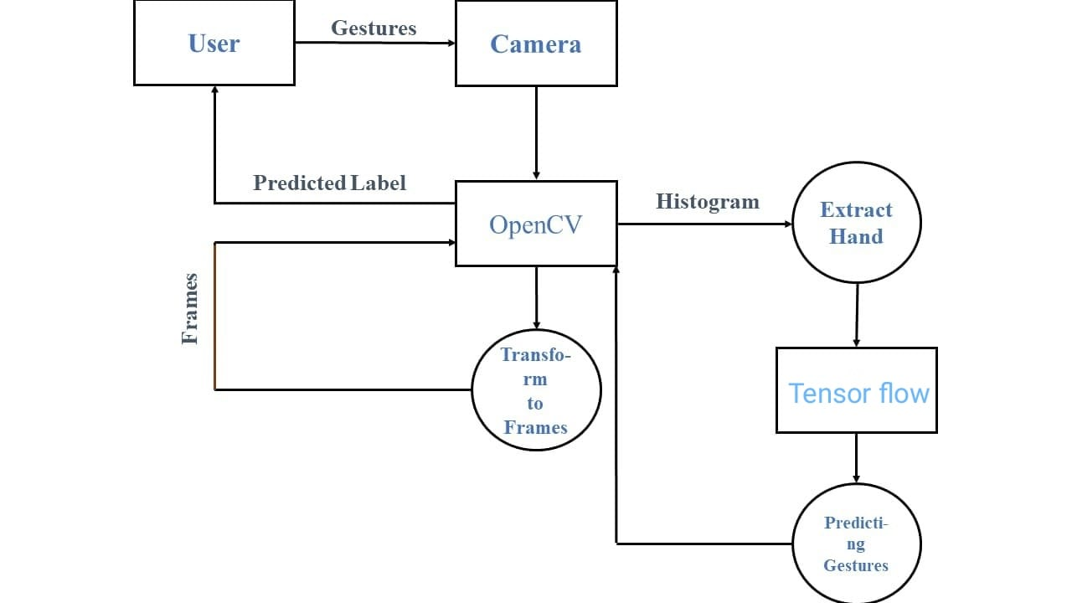
Data flow diagram

Slide 7
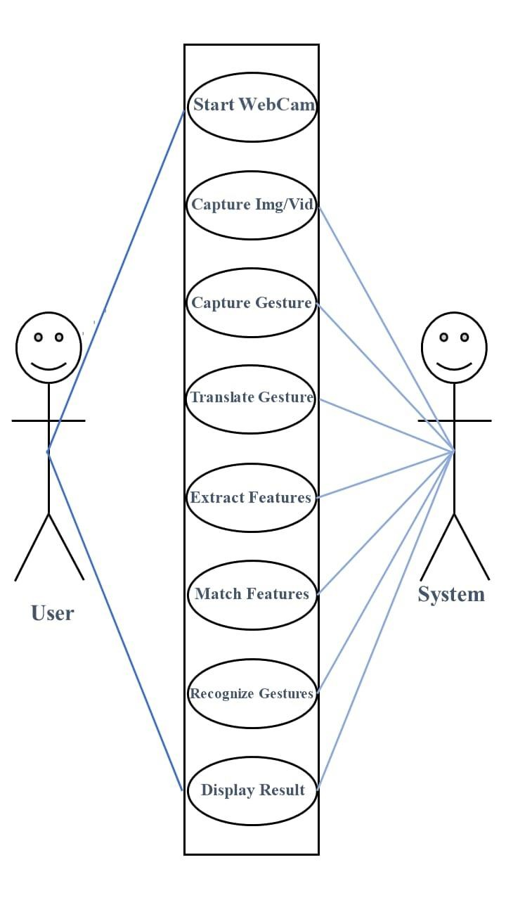
Use case diagram

Slide 8
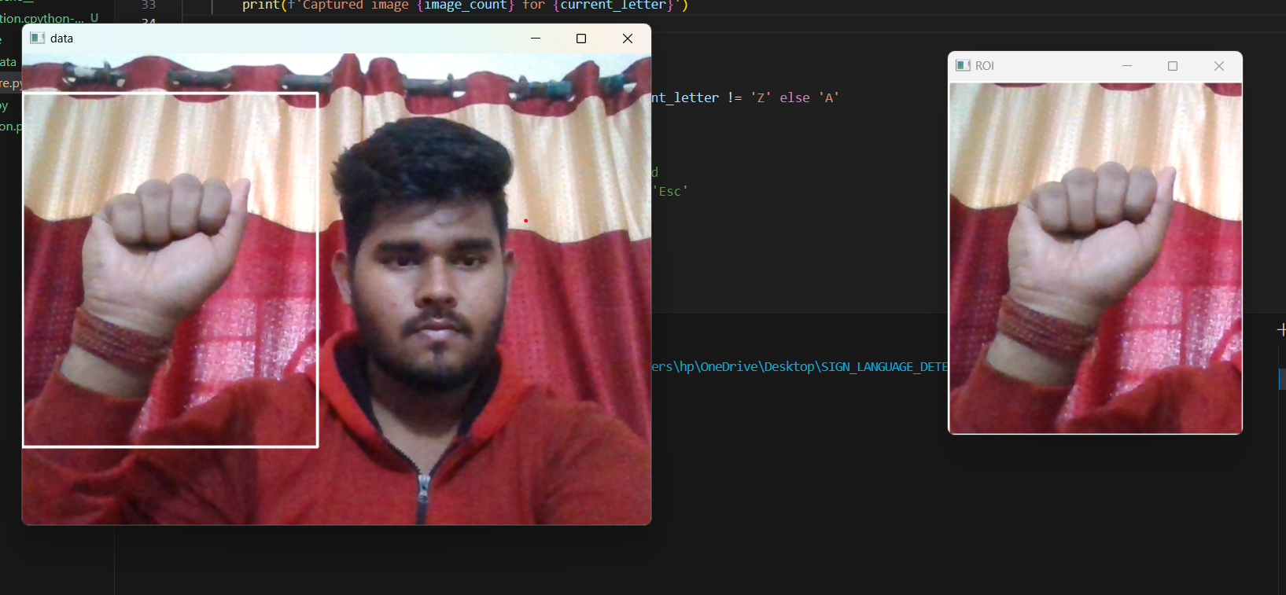
HOW WE CREATED OUR DATASET?

Slide 9
Application
Users can use sign language to easily communicate with devices without physically touching them.
It can then be used to help people who are just beginning to learn Sign Language or those who don't know sign language but have a close one who is deaf.
Helps the mute and deaf people to communicate with normal peoples with the use of Sign Language Recognition (SLR) system.

Slide 10
Hardware and software used
Software requirements:
- Operating System : Windows, Mac, Linux
- SDK: OpenCV, TensorFlow, Python, Media pipe
Hardware Requirements
The Hardware Interfaces Required are:
Camera: Good quality
Ram: Minimum 8GB
Processor: Intel Pentium 4 or higher

Slide 11
Conclusion
In conclusion, the Sign Language Detection Project represents a pivotal advancement in accessibility and communication. By harnessing cutting-edge technology like computer vision and machine learning, this innovation transcends barriers, fostering inclusive interactions in education, healthcare, customer service, and beyond. This project marks a significant stride towards a more inclusive world, where communication knows no bounds.

Slide 12
FUTURE SCOPE
We are planning to achieve higher accuracy even in case of complex
backgrounds by trying out various background subtraction algorithms.
❖ We are also thinking of improving the preprocessing to predict gestures in low light conditions with a higher accuracy.

Slide 13
References
[1]Guo D, Zhou W, Wang M, Li H. Sign language recognition based on adaptive HMMs with data augmentation. Proceedings - International Conference on Image Processing, ICIP. 2016; 2016-Augus: p. 2876-2880.
[2] Jin CM, Omar Z, Jaward MH. A mobile application of American sign language translation via image processing algorithms. Proceedings - 2016 IEEE Region 10 Symposium, TENSYMP 2016. 2016;
Links:
https://www.geeksforgeeks.org/sign-language-recognition-system-using-tensorflow-in-python/
https://learnopencv.com/introduction-to-mediapipe/
https://www.geeksforgeeks.org/machine-learning/

Slide 14
THANK YOU

